Slide 1
exceptions
JDBC Database Access

Slide 2
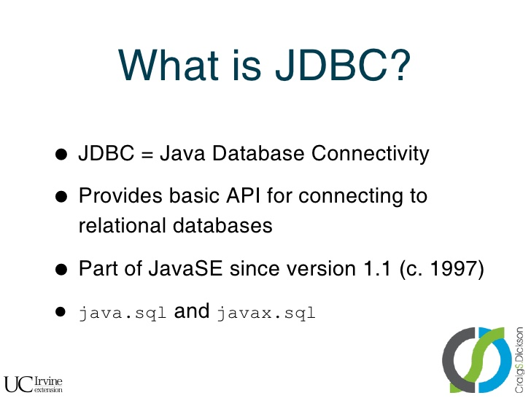

exceptions

Slide 3
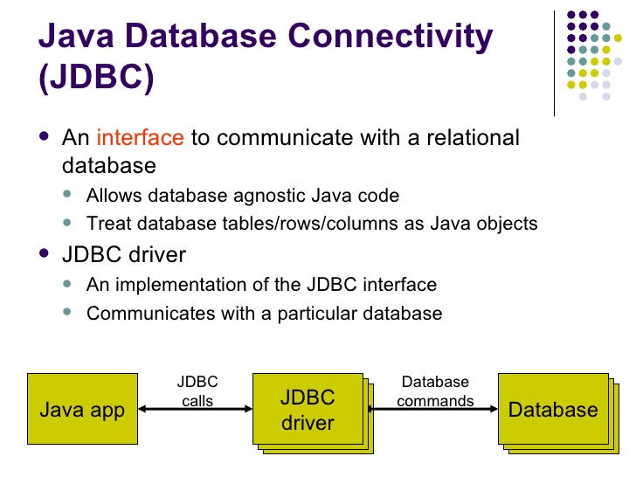
exceptions

Slide 4
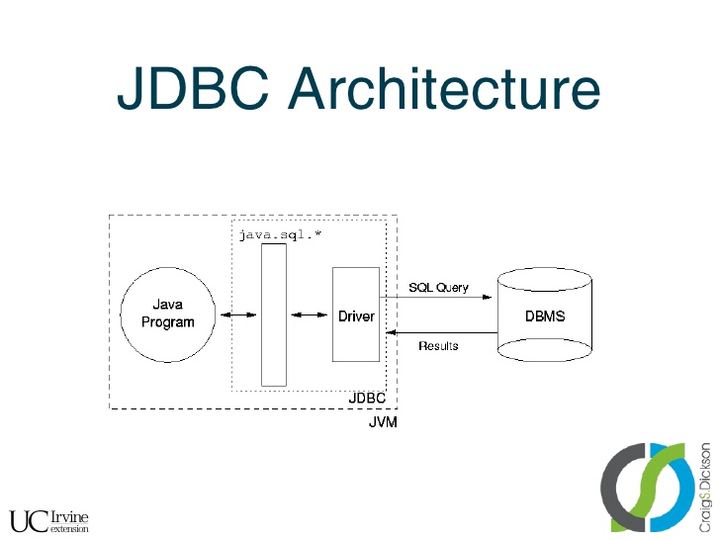
exceptions

Slide 5
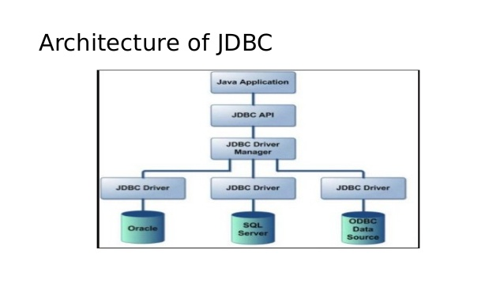
exceptions

Slide 6
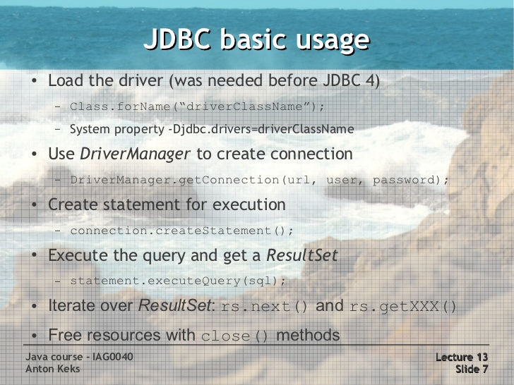
exceptions

Slide 7
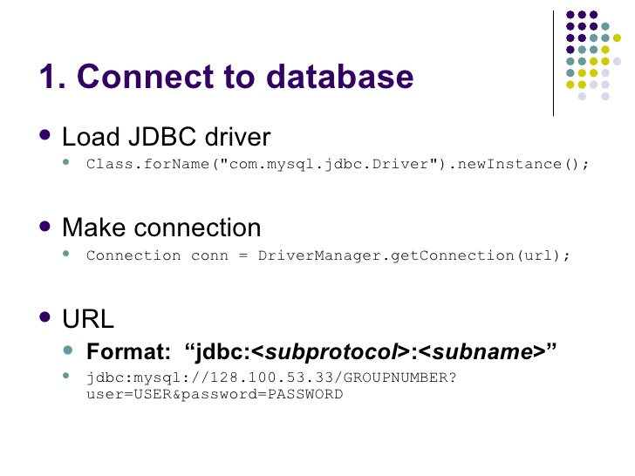
exceptions

Slide 8
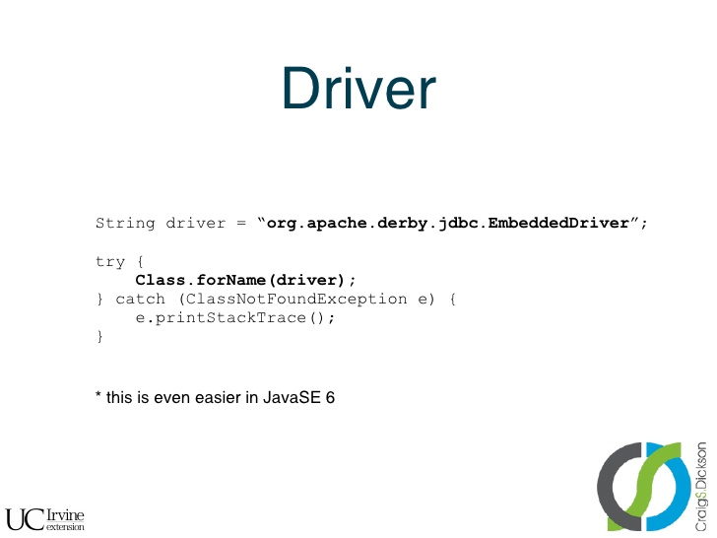
exceptions

Slide 9
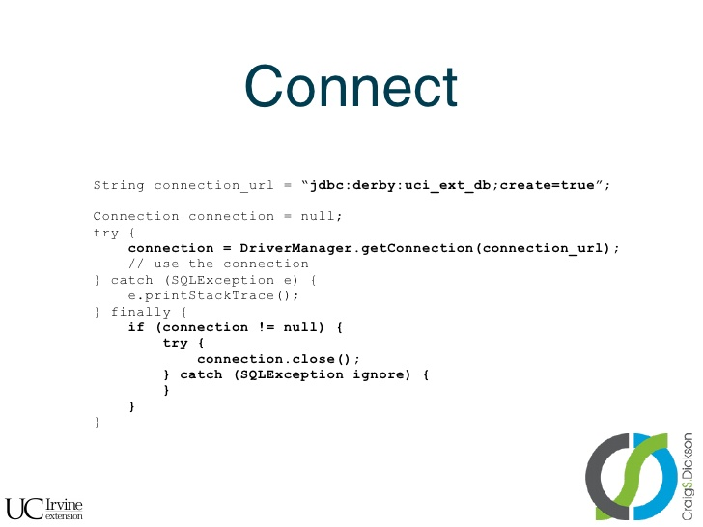
exceptions

Slide 10
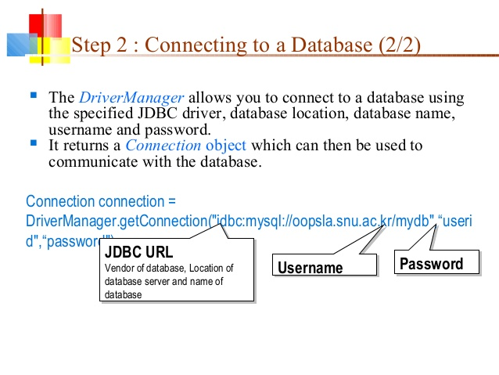
exceptions

Slide 11
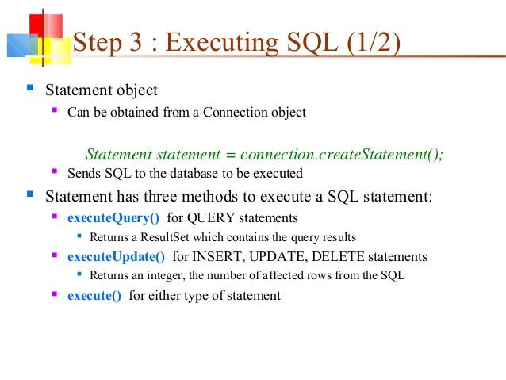
exceptions

Slide 12
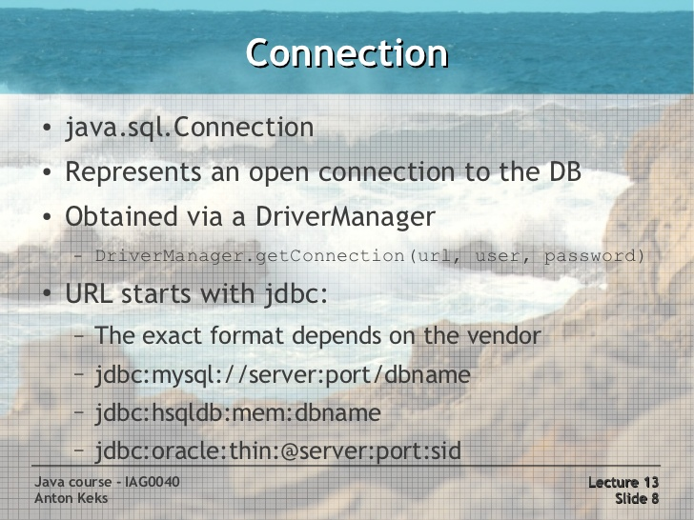
exceptions

Slide 13
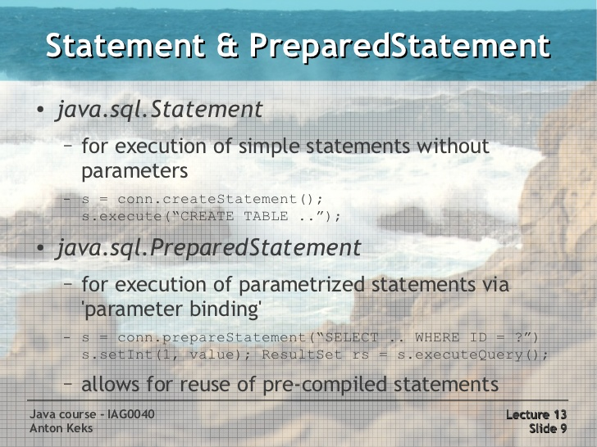
exceptions

Slide 14
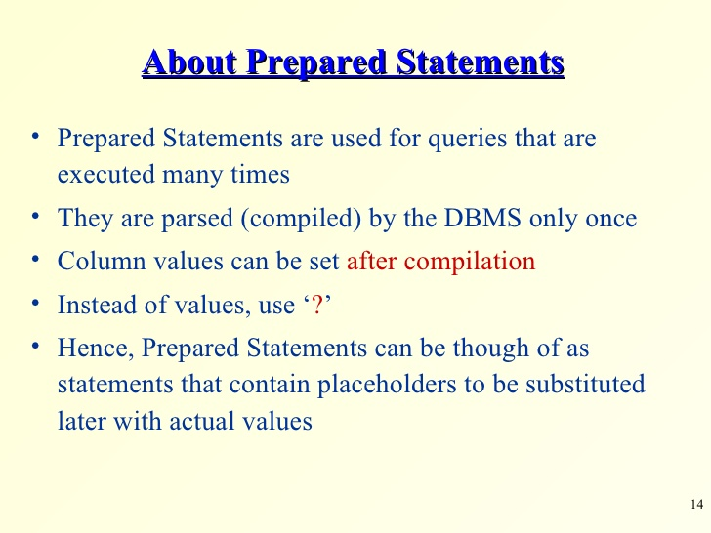
exceptions

Slide 15
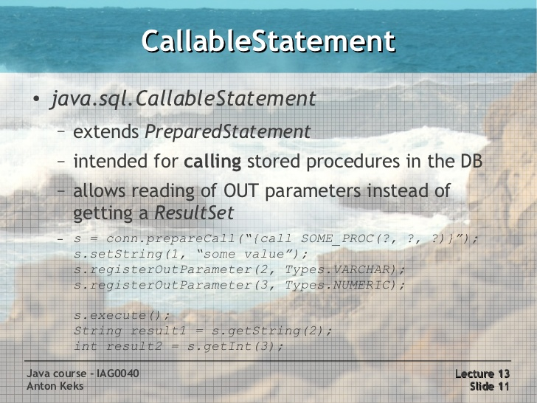
exceptions

Slide 16
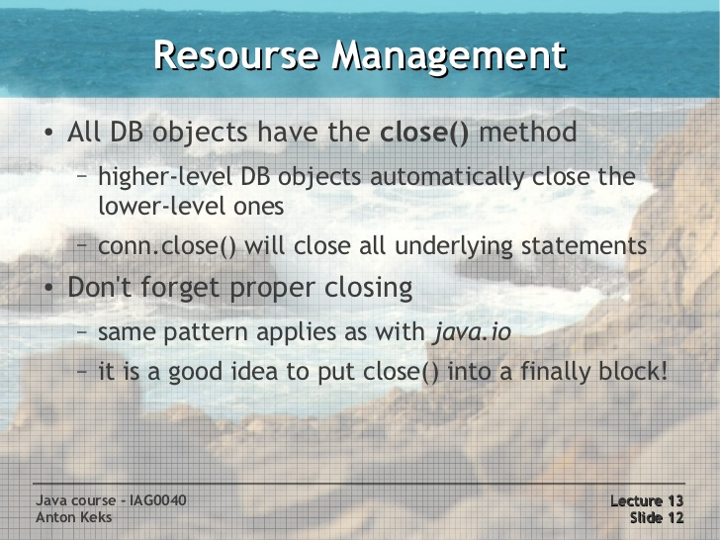
exceptions

Slide 17
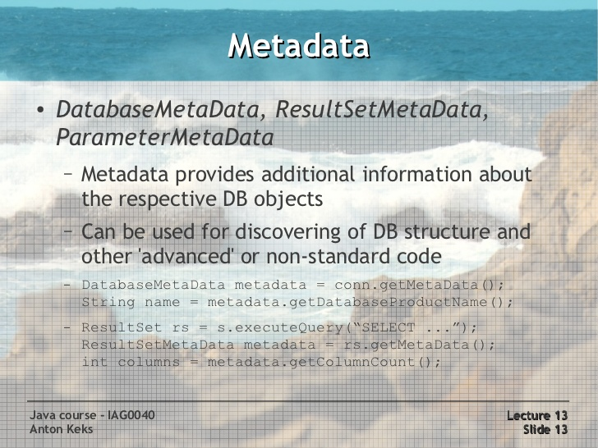
exceptions

Slide 18
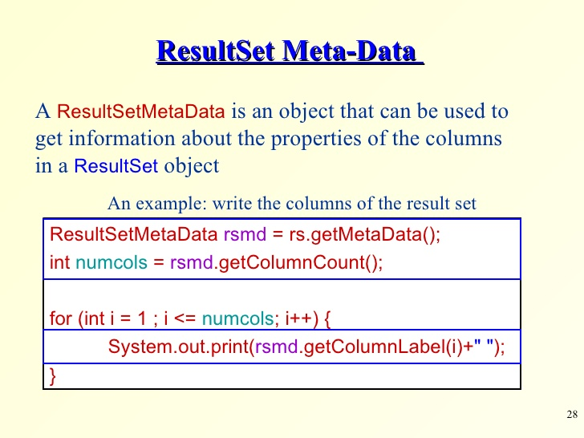
exceptions

Slide 19
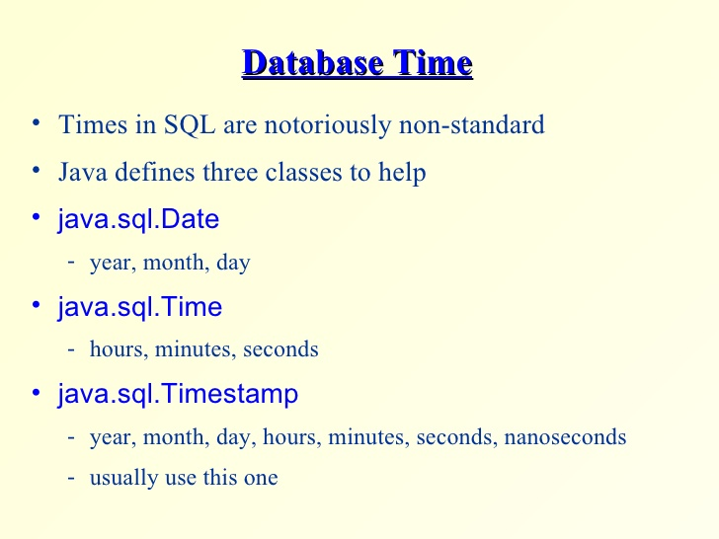
exceptions

Slide 20
exceptions

Slide 21
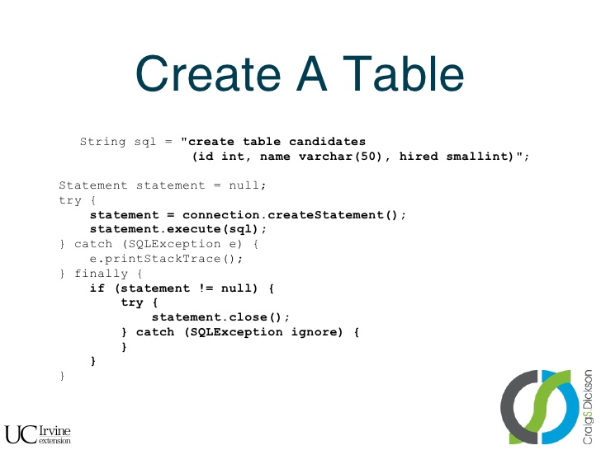
exceptions

Slide 22
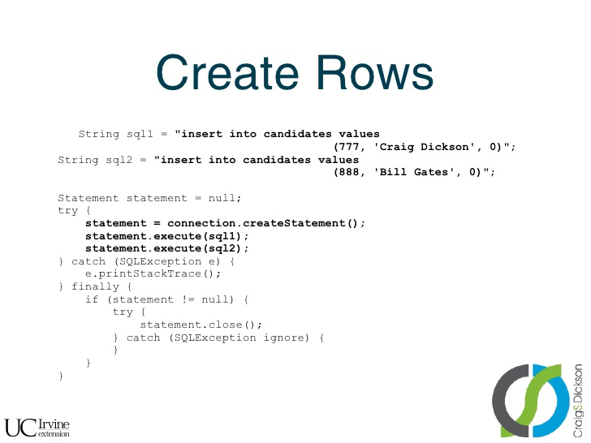
exceptions

Slide 23
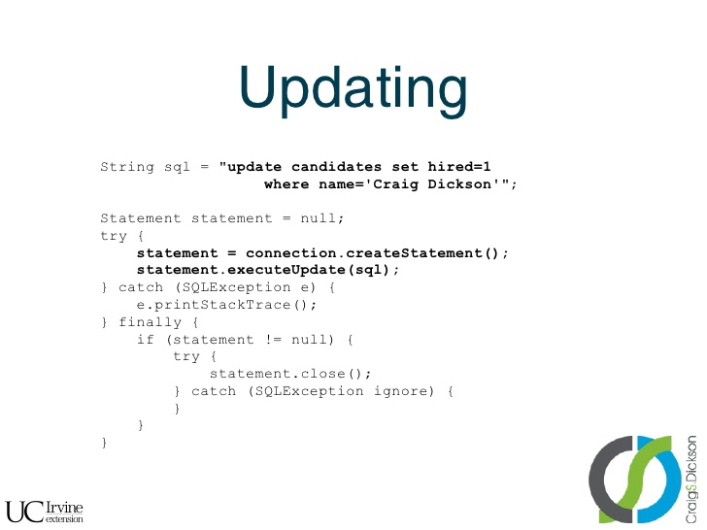
exceptions

Slide 24
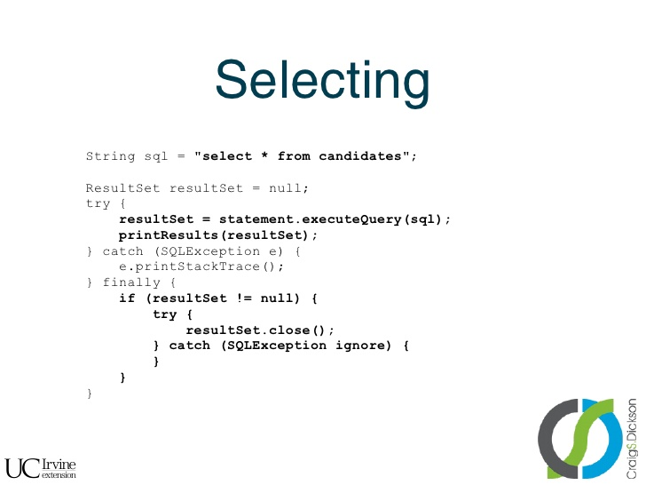
exceptions

Slide 25
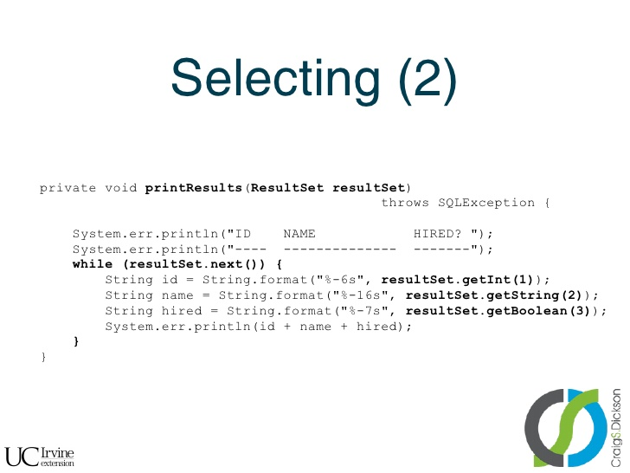
exceptions

Slide 26
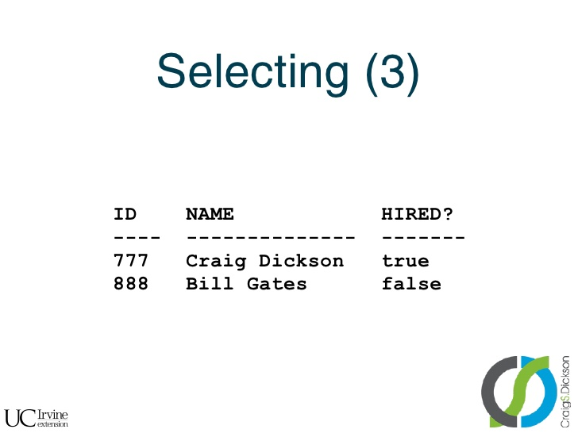
exceptions

Slide 27
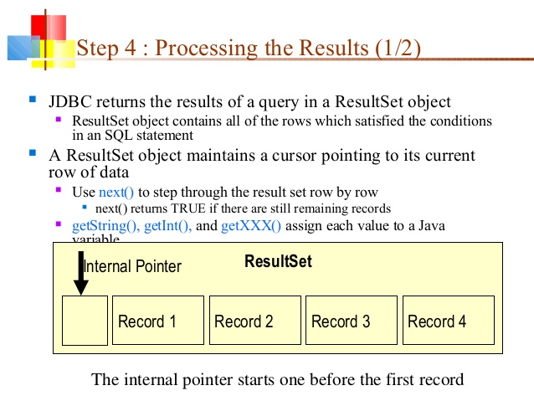
exceptions

Slide 28
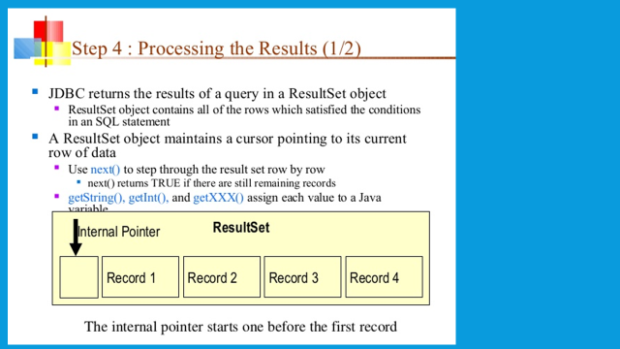
exceptions

Slide 29
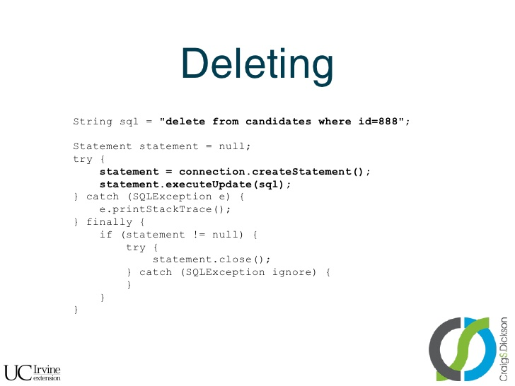
exceptions

Slide 30
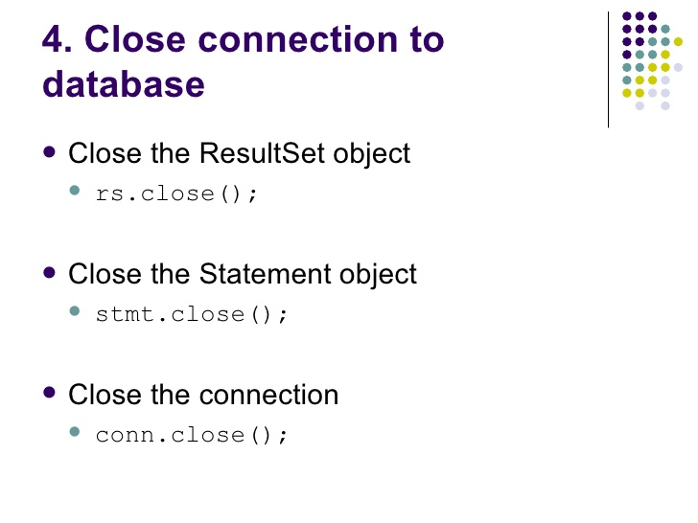
exceptions

Slide 31
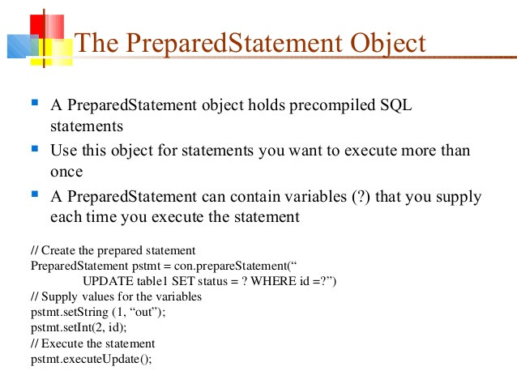
exceptions

Slide 32
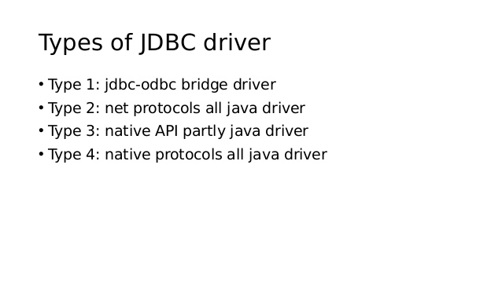
exceptions

Slide 33
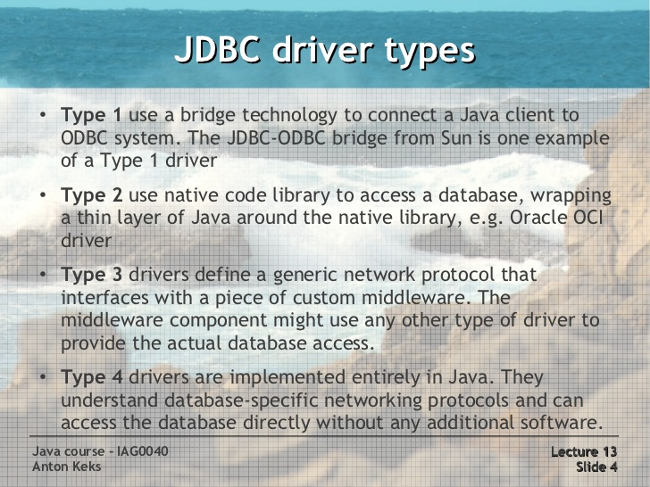
exceptions

Slide 34
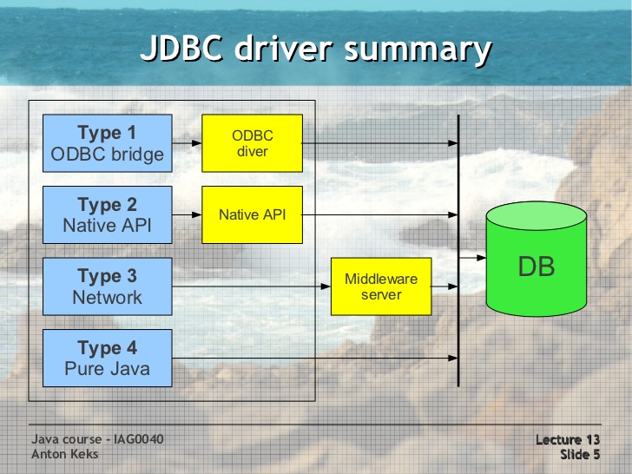
exceptions

Slide 35
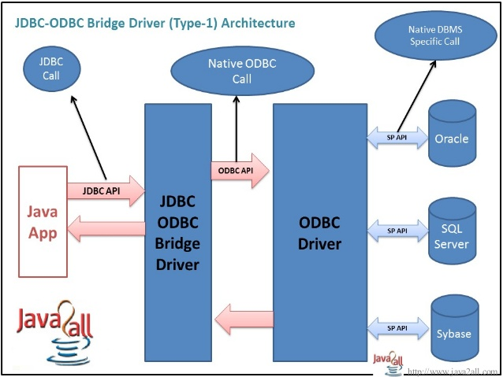
exceptions

Slide 36
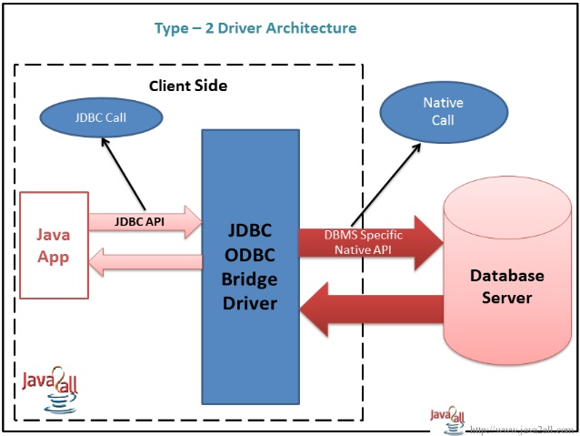
exceptions

Slide 37
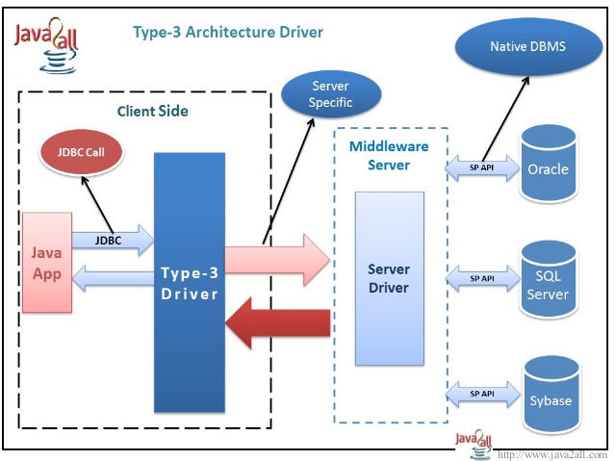
exceptions

Slide 38
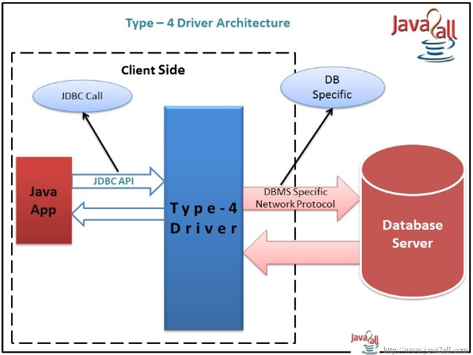
exceptions

Slide 39
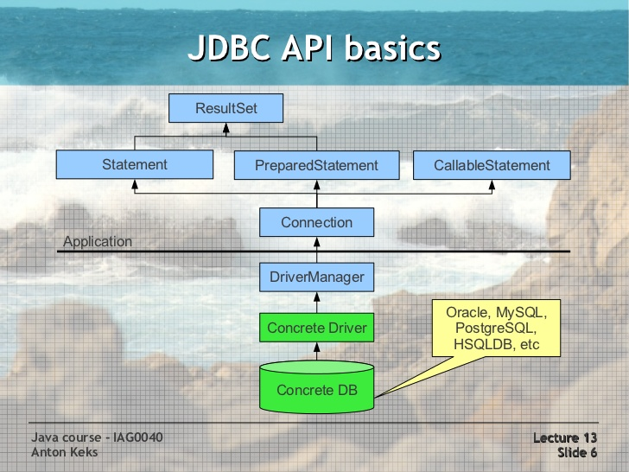
exceptions

Slide 40
exceptions
ResultSet and Cursors
The rows that satisfy the conditions of a query are called the result set.
The number of rows returned in a result set can be zero, one, or many.
A user can access the data in a result set one row at a time, and a cursor provides the means to do that.
A cursor can be thought of as a pointer into a file that contains the rows of the result set, and that pointer has the ability to keep track of which row is currently being accessed.
Most DBMSs create a cursor automatically when a result set is generated.
Result set's cursor can be moved both forward and backward and also allowing it to move to a specified row or to a row whose position is relative to another row.

Slide 41
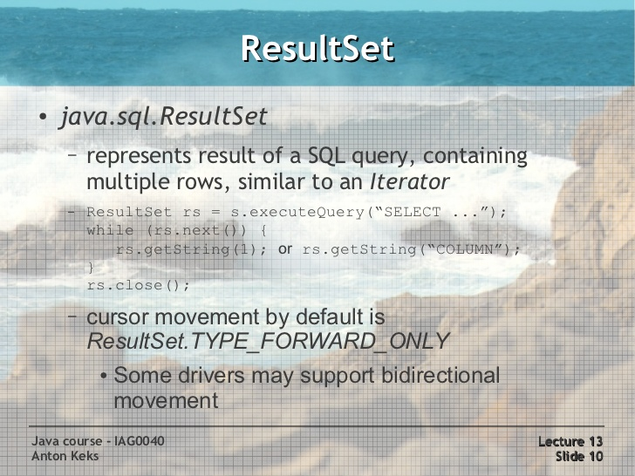
exceptions

Slide 42
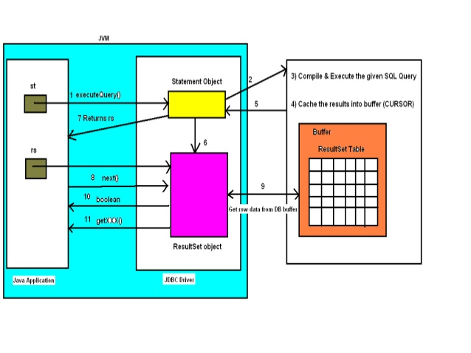
exceptions

Slide 43
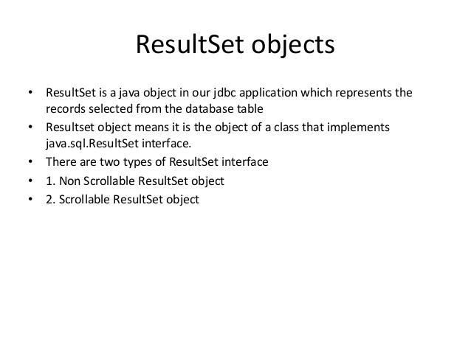
exceptions

Slide 44
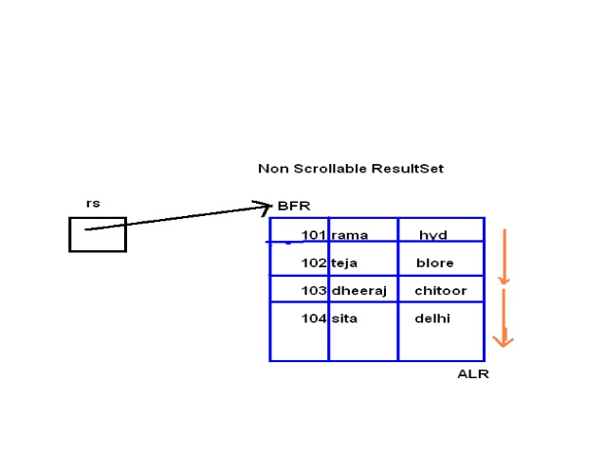
exceptions

Slide 45
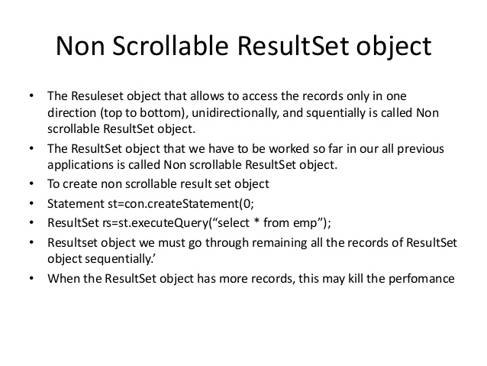
exceptions

Slide 46
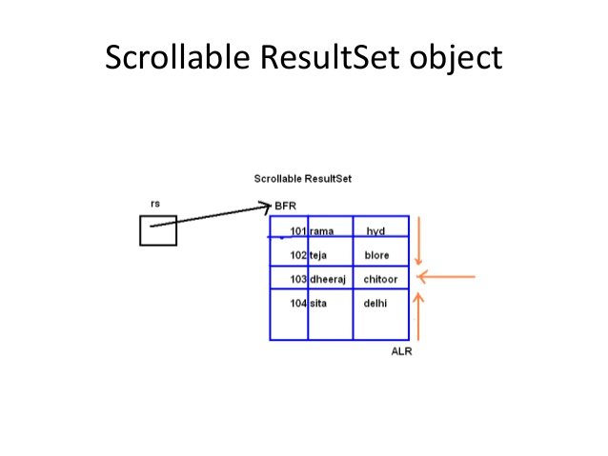
exceptions

Slide 47
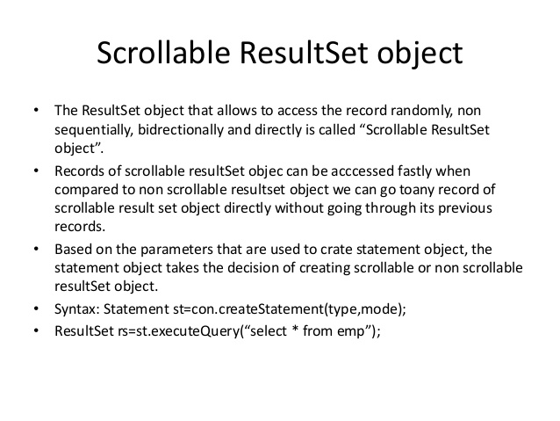
exceptions

Slide 48
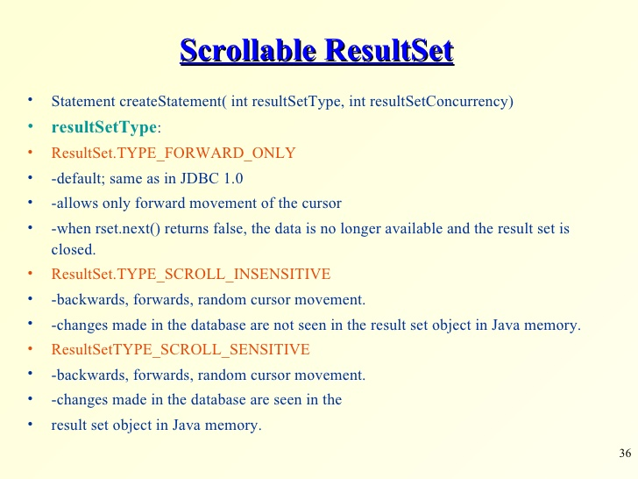
exceptions

Slide 49
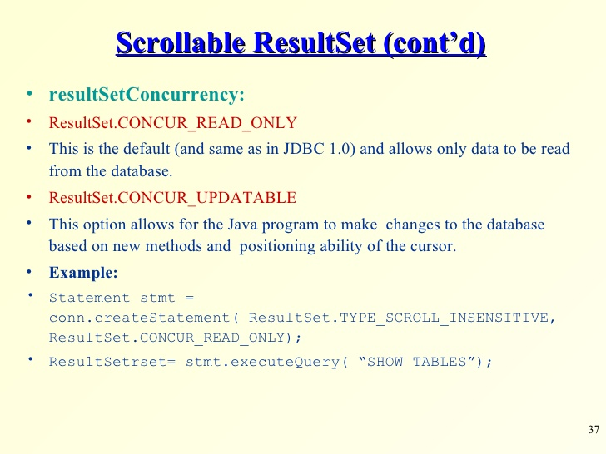
exceptions

Slide 50
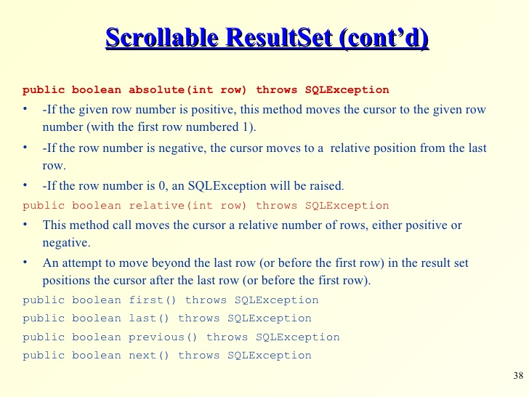
exceptions

Slide 51
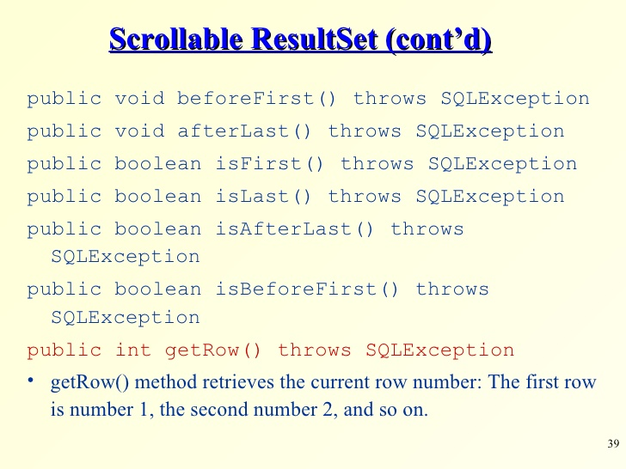
exceptions

Slide 52
exceptions

Slide 53
exceptions

Slide 54
exceptions

Slide 55
exceptions

Slide 56
exceptions

Slide 57
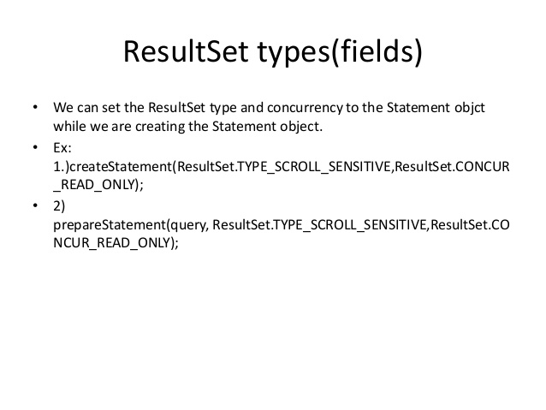
exceptions

Slide 58
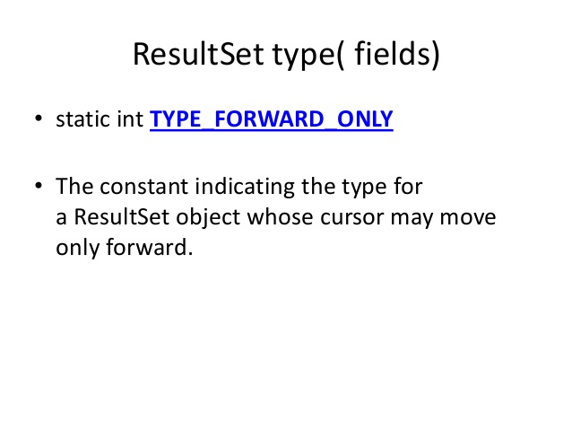
exceptions

Slide 59

exceptions

Slide 60

exceptions

Slide 61

exceptions

Slide 62

exceptions

Slide 63

exceptions

Slide 64

exceptions

Slide 65

exceptions

Slide 66

exceptions

Slide 67

exceptions

Slide 68

exceptions

Slide 69

exceptions

Slide 70

exceptions

Slide 71

exceptions

Slide 72

exceptions

Slide 73
exceptions

Slide 74

exceptions

Slide 75

exceptions

Slide 76

exceptions

Slide 77

exceptions

Slide 78

exceptions

Slide 79

exceptions

Slide 80
exceptions
Transaction Locks:
Lock :
Mechanism that prohibits two transactions from manipulating the same data at the same time.
Table Lock:
Prevents a table from being dropped if there is an uncommitted transaction on that table.
Row Lock:
A row lock prevents two transactions from modifying the same row, or it prevents one transaction from selecting a row while another transaction is still modifying it.

Slide 81

exceptions

Slide 82

exceptions

Slide 83
exceptions

Slide 84
exceptions

Slide 85
exceptions
Running Eclipse

Slide 86
exceptions
References:
http://www.slideshare.net/itsec/jdbc-tutorial
http://www.slideshare.net/myrajendra/interface-result-set
http://www.slideshare.net/antonkeks/java-course-13-jdbc-db-access
http://www.slideshare.net/itsec/jdbc-java-database-connectivity-4071670

Slide 87
Java - miscellaneous
Type Comparison Operator instanceof
The instanceof operator compares an object to a specified type.
You can use it to test if an object is an instance of a class, an instance of a subclass, or an instance of a class that implements a particular interface
Classes implementing interfaces
class MyClass extends MySuperClass implements YourInterface {
// field, constructor, and
// method declarations
}

Slide 88
Java - miscellaneous
Varargs – Specifying Arbitrary number of arguments
public Polygon polygonFrom(Point... corners) {
int numberOfSides = corners.length;
double squareOfSide1, lengthOfSide1;
squareOfSide1 = (corners[1].x - corners[0].x)
* (corners[1].x - corners[0].x)
+ (corners[1].y - corners[0].y)
* (corners[1].y - corners[0].y);
lengthOfSide1 = Math.sqrt(squareOfSide1);
// more method body code follows that creates and returns a
// polygon connecting the Points
}
You will most commonly see varargs with the printing methods; for example, this printf method:
public PrintStream printf(String format, Object... args)
allows you to print an arbitrary number of objects. It can be called like this:
System.out.printf("%s: %d, %s%n", name, idnum, address);

Slide 89

Java - miscellaneous
Returning a Class or Interface
When a method uses a class name as its return type the class of the type of the returned object must be either a subclass of, or the exact class of, the return type.
public Number returnANumber() {
...
}
The returnANumber method can return an ImaginaryNumber but not an Object. ImaginaryNumber is a Number because it's a subclass of Number. However, an Object is not necessarily a Number — it could be a String or another type

Slide 90
Advanced java
Garbage collection
JDBC
Lambda expressions
Annotations
Aggregate operations on collection using Lambarda expression.
Java streaming
Blocking queue
Aggregate operations
Autoboxing and unboxing

Slide 91
https://docs.oracle.com/javase/tutorial/reallybigindex.html
http://www.slideshare.net/EdurekaIN/java-class-3
http://www.slideshare.net/abdurrehmanabdurrehman391/variables-and-data-types-by-sir-khalid
http://www.slideshare.net/abdurrehmanabdurrehman391/java-advancedoop
http://www.slideshare.net/MindfireSolutions/java-garbage-collection-how-it-works?next_slideshow=1
http://www.slideshare.net/arnold7490/unit-4-java
http://www.slideshare.net/arnold7490/unit-3-java?next_slideshow=1
http://www.slideshare.net/tushardesarda/java-tutorial-3
http://www.slideshare.net/muralidhar9e/java-exception-handling-ppt
http://www.slideshare.net/emprovise/2-javabasics
http://www.slideshare.net/AllanHuang/java-new-evolution
http://www.slideshare.net/antonkeks/4-collections
http://www.slideshare.net/andreaiacono/java8-39841939 - Java8 features
http://www.slideshare.net/AbhishekKhune/07-java-collection
http://www.slideshare.net/shahjahan786/generics-27960064 - Generics
http://www.slideshare.net/caroljmcdonald/java-generics-2485138?next_slideshow=1

Slide 92
http://www.slideshare.net/KavitaGanesan/is-66154415-kavitaganesanv2 - Strings
http://www.slideshare.net/antonkeks/10-threads - Threads
http://www.slideshare.net/BenjDelMundo/java-thread-synchronization - Synchronization
http://www.slideshare.net/javaonkar/thread-concurrancy - Synchronization
http://www.slideshare.net/lineking/io-package - Basic IO
http://new.51cto.com – Buffered streams.
http://www.slideshare.net/EmertxeSlides/010-core-javaiofundamentals - IO
http://www.slideshare.net/martyhall/file-io-in-java-8-applying-the-power-of-streams - File IO
http://www.slideshare.net/boulderjug/55-things-in-java-7 - File IO

